Slide 1
BOOST – Boosting the implementation of high-quality community-based communicable disease services as part of a comprehensive, people-centred and integrated harm reduction approach for people who use drugs and related vulnerable groups
Project acronym: BOOST Project

Slide 2
Main aim: to enhance the implementation of high-quality community-based communicable disease services as part of a comprehensive, people-centred and integrated harm reduction approach in four key areas:
INFORM: collection of information and data on community-based services for PWUD
IMPROVE: organisation of capacity building in the field of communicable disease
SUPPORT: enhancing scale-up of integrated community-based good practices
CONNECT&ACT: consolidating PWUD networks and fostering advocacy interventions
At the core of the BOOST project are three European harm reduction networks with support of the European Network of People who Use Drugs :
Correlation – European Harm Reduction Network (C-EHRN), covering 34 countries with a focus on the European Union and neighbouring countries;
Eurasian Harm Reduction Association (EHRA), covering 45 countries with a focus on Eastern Europe and Central Asia;
Drug Policy Network South East Europe (DPNSEE), covering 8 countries with a focus on Southern-Eastern Europe.

Slide 3
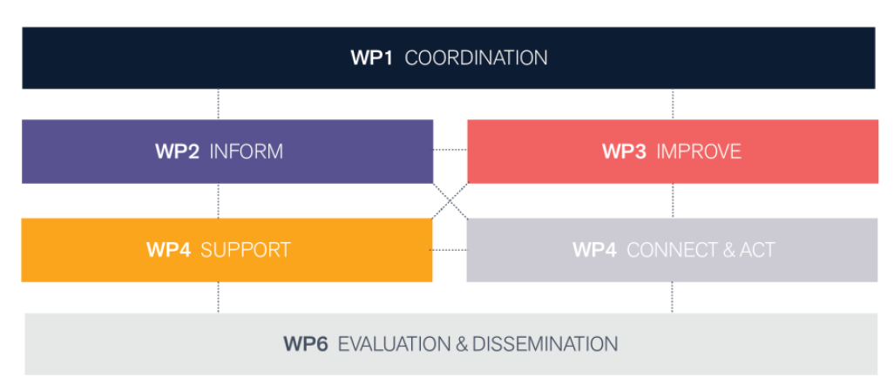

Slide 4
